Slide 1
Walmart Sales Forecast
Charles, Devangi, Hard, Jasmine, Kunal, Zhe
Feb. 21 2021

Slide 2
Introduction
Data Exploration
SARIMA Modeling
MSPE Evaluation
SARIMA Modeling with additional Variables
MSPE Evaluation
Prophet Modeling
MSPE evaluation
Conclusion

Slide 3
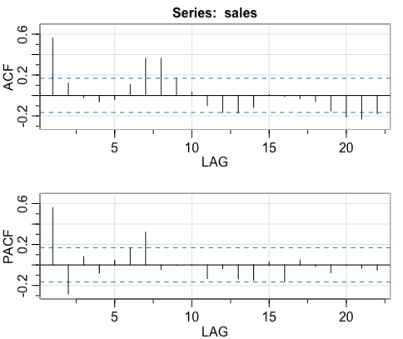
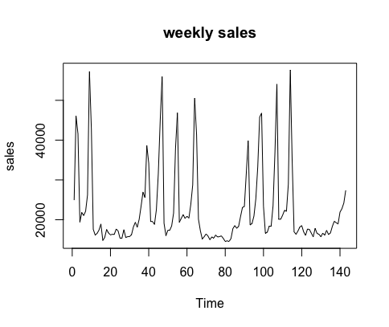
Data Exploration
Data: Weekly Sales for Store 1 Department 1

Slide 4
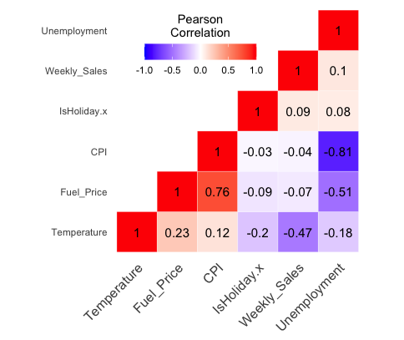
Data Exploration
Negative correlation for Weekly Sales and Temperature
Positive correlation between Weekly Sales and Unemployment

Slide 5
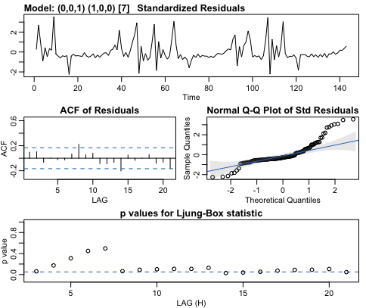
SARIMA without Additional Variables
SARIMA(0,0,1,1,0,0,7)
Several p values fall below the line after lag 7, which means the residuals are correlated

Slide 6
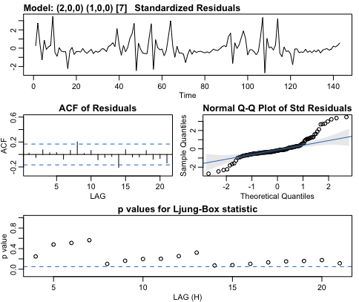
SARIMA without Additional Variables
SARIMA(2,0,0,1,0,0,7)
All the p values are above the blue line, which means the residuals are independent

Slide 7

SARIMA without Additional Variables
SARIMA(2,0,1,1,0,0,7)
p values are in the line at lag 14 and lag 15, which means the residuals are correlated at lag 14 and lag 15

Slide 8
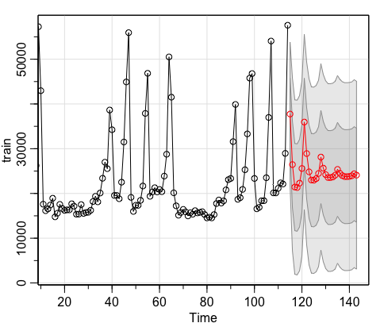
MSPE Evaluation
Our data contains 143 observations of weekly sales:
Train: 1 to 114
Test: 115 to 143
SARIMA model without additional variables:
ARIMA(2,0,0)*(1,0,0) for prediction.
MSPE: 56,753,140

Slide 9
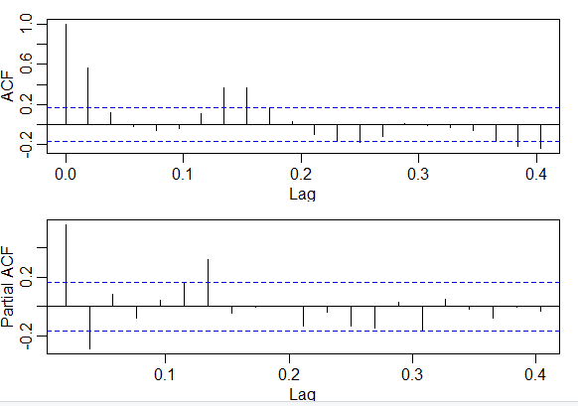
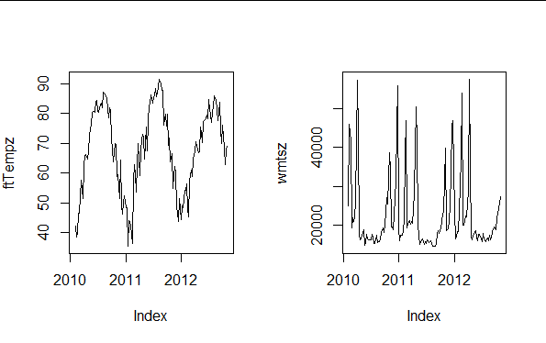
SARIMA Modeling with Additional Variables
Additional variables used: Temperature & Unemployment

Slide 10
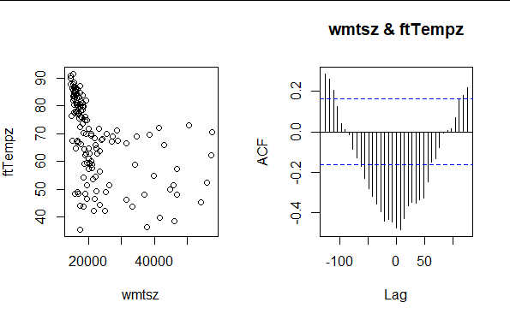
SARIMA Modeling with Additional Variables
Additional variables used: Temperature & Unemployment
Looking at the two graphs:
As temperature decreases, we see an increase in sales
We also see, using the CCF function, there is a clear cross correlation between sales and temperature over time.

Slide 11
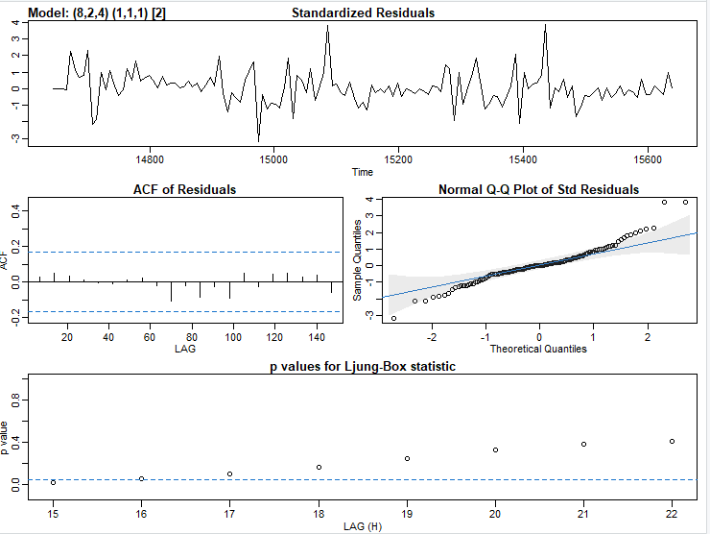
SARIMA Modeling with Additional Variables
SARIMA(8,2,4)(1,1,1)[2]

Slide 12
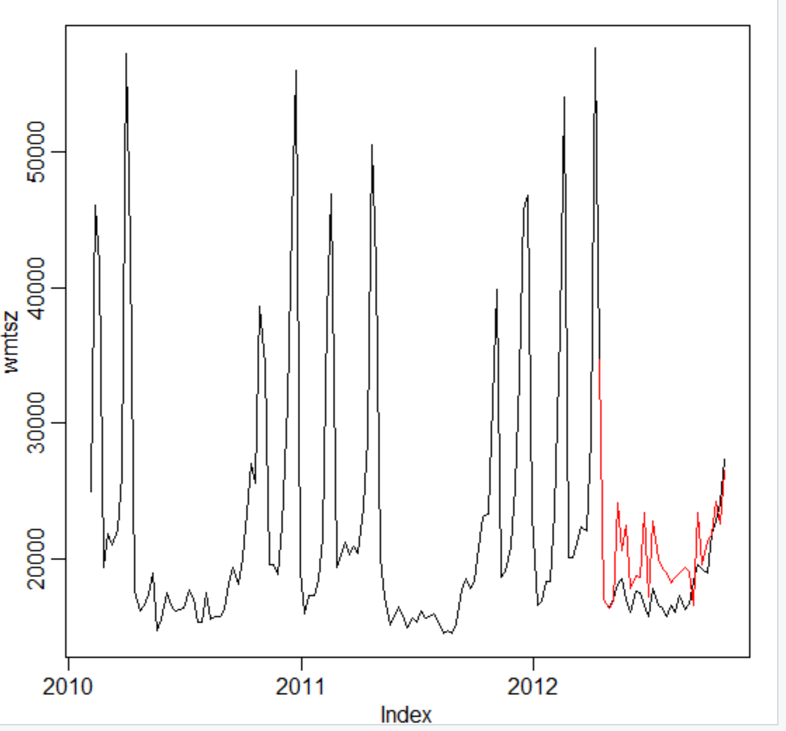
MSPE Evaluation
MSPE (SARIMA with Temperature): 8,176,171

Slide 13
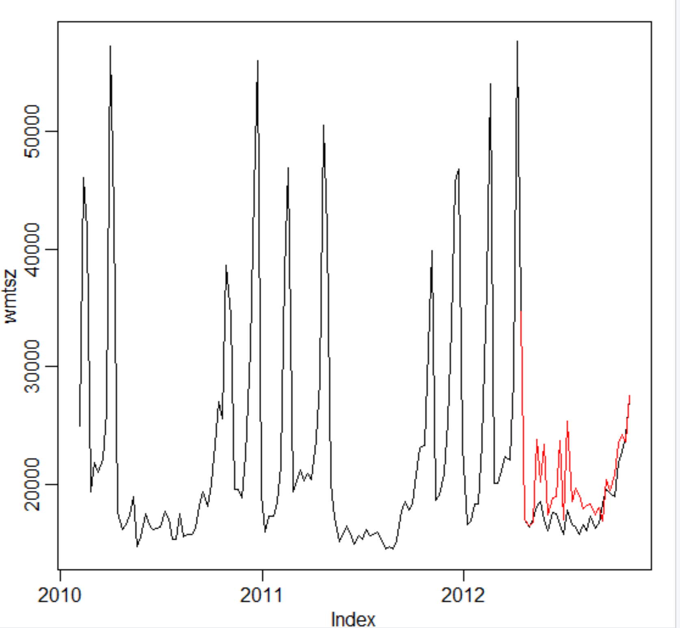
MSPE Evaluation
MSPE (SARIMA with Unemployment): 8,208,238

Slide 14
Prophet Model
Prophet modeling is an Automated Forecasting Procedure which forecasts time series data based on an additive model where non-linear trends are fit with yearly, weekly, and daily seasonality, plus holiday effects.
It works best with time series that have strong seasonal effects and several seasons of historical data.
Prophet modeling is robust to missing data and shifts in the trend, and typically handles outliers well.

Slide 15
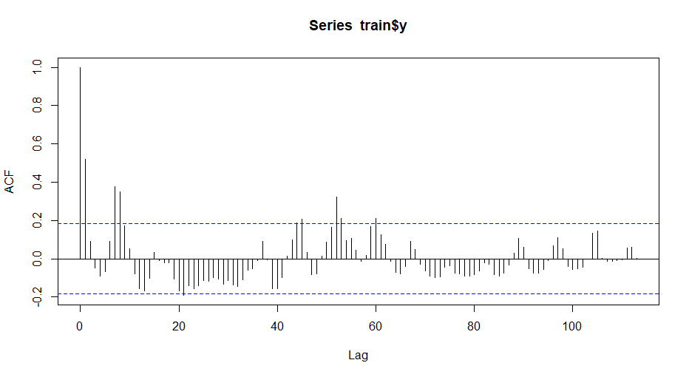
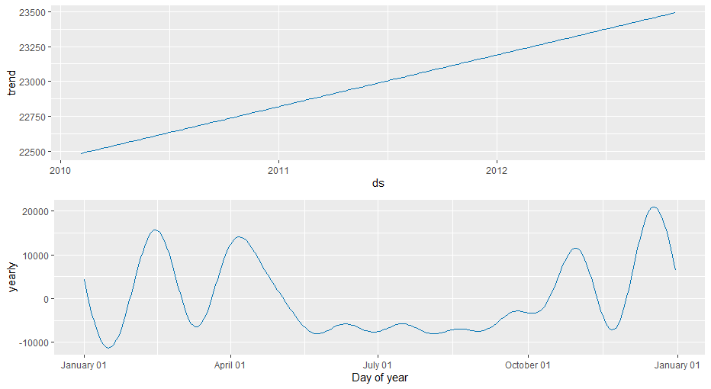
Prophet Model Implementation
ACF Plot - Training Time Series Dataset:
Capturing significant reversals in trend
Prophet Model Components:
Forecasting Yearly Trends by Year and Month
4
7
3
5
6
1
2

Slide 16
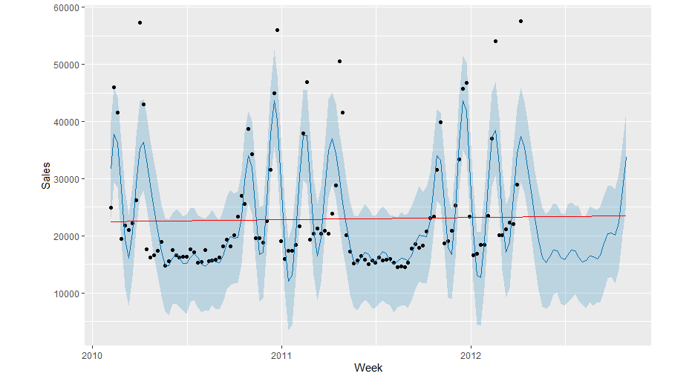
Prophet Model Weekly Sales Forecast

Slide 17
MSPE Evaluation
Initial MSPE: 14,669,985 (n.changepoints = 7)
Model Experimentation and Impact:
Considering Weekly Seasonality during Model Training
(weekly.seasonality = TRUE)
MSPE: 15,057,099 (MSPE increased; parameter rejected)
Modelling Holiday Effects
MSPE: 15,057,099 (MSPE increased; parameter rejected)
Changing n.changepoints = 25 (Default for Prophet)
MSPE: 16,699,228 (MSPE increased; parameter rejected)

Slide 18
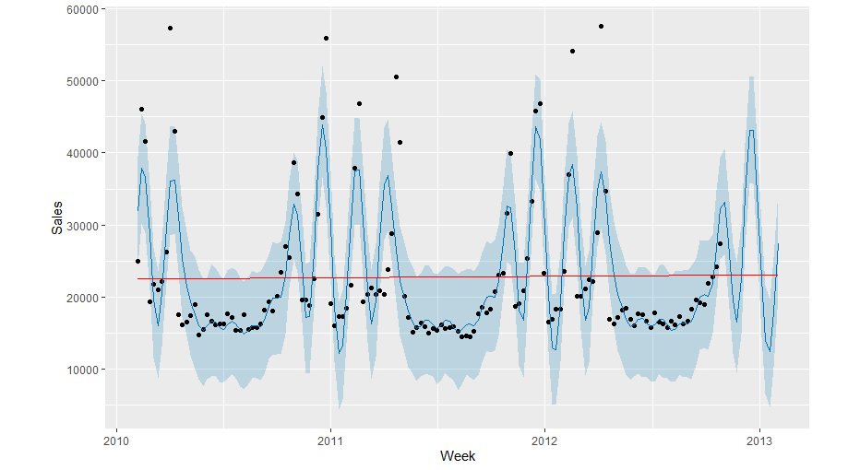
Forecasting Sales for 14 weeks beyond Available Data

Slide 19
Conclusion
Explored 3 different types of methods: SARIMA, SARIMA with additional features and Prophet.
Fitted models for each of the above methods. Trained the model on the training dataset and predicted on the test dataset.
Among these 3 methods, SARIMA with temperature has the lowest MSPE.

Slide 20
Thank you!

